Slide 1

Nutrition and Energy Metabolism Related Aspect of Breast Cancer
Siska Wiramihardja
EHASP Breast Cancer Team
ALLPPT.com _ Free PowerPoint Templates, Diagrams and Charts

Slide 2
Ingredients
01
Breast Cancer in Indonesia
02
Nutritional Status and Breast Cancer :
Obesity perspective
03
Obesity and Energy Metabolism
04
You are What You Eat Concept
05
Take Home Messages

Slide 3
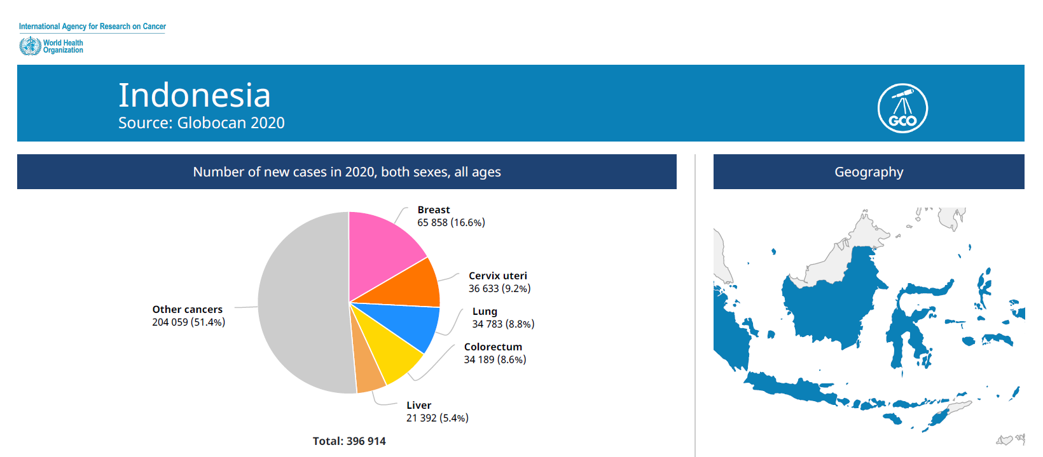

Breast Cancer in Indonesia
01
Breast Cancer
65.858 incidence in 2020
Cervical cancer
36.633 incidence in 2020
Lung cancer
16.6%
34.783 incidence in 2020
9.2%
8.8 %
Colorectal cancer
34.189 incidence in 2020
8.6%
World Health Organization. Globocan, 2020

Slide 4
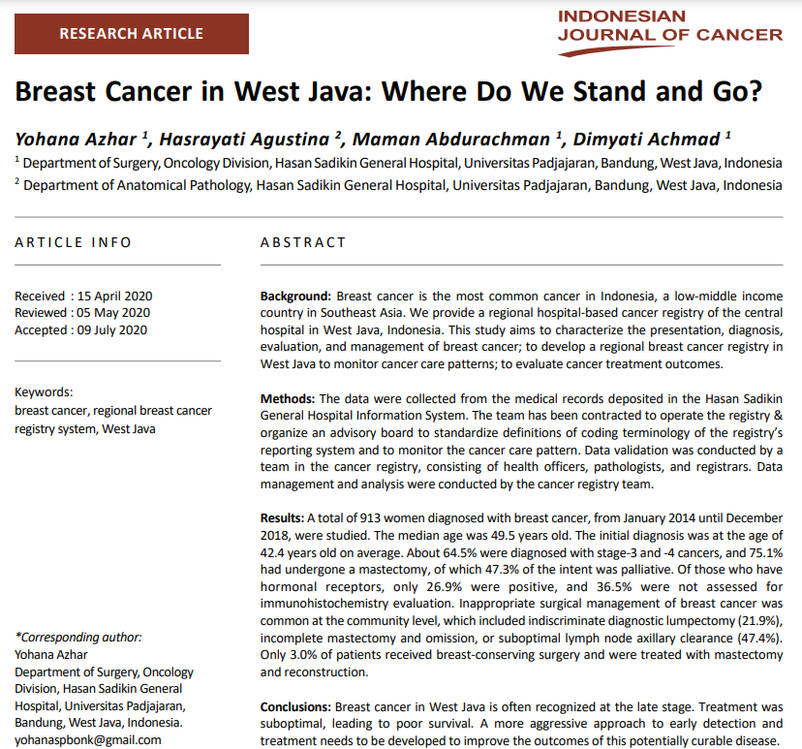
Breast Cancer in West Java

Slide 5
Natural History of Breast Cancer
Mortality
Recurrence
Palliative
2nd Preventive
Rehabilitative
Survive
Diagnostic
Rehabilitative
Curative
Curative
Early Detection
Risk Factor
1st Preventive
1st Preventive
Promotive

Slide 6
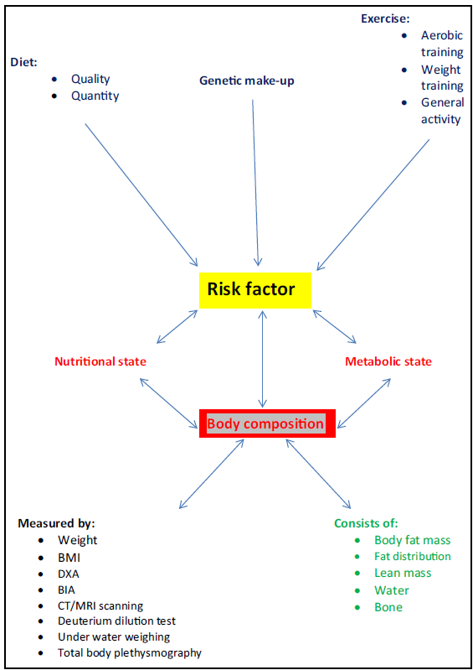
Nutritional Status and Breast Cancer
02
The importance of this risk factor, not only
in influencing breast cancer incidence, but also its association
with poorer clinical outcomes after diagnosis, it
is crucial to characterize more precisely the aspects of
body composition, or associated metabolic or physiological
factors, that underlie the observed association.
It is then important to identify how it can be assessed
clinically, whether it can be influenced and whether this
can reduce risk and improve outcomes.
James FR, et al. Obesity in breast cancer – What is the risk factor ? Eur J Cancer, 2015

Slide 7

The Obesity- Breast Cancer Link
Obesity promotion of the incidence and progression of breast cancer poses a significant public health hazard. Delineation of the mechanisms through which obesity drives cancer progression or immune evasion is critical for the development of interventions to effectively disrupt obesity-driven cancer with minimum toxicity. Dietary interventions remain of considerable interest due to their co-targeting of metabolic disruptions. Breaking the obesity and breast cancer link will require interventions that limit the protumor effects of obesity-associated adipose dysregulation and that consider other biological and genetic mediators and structural determinants of health disparities. Moreover, given the high and rising rates of obesity in many parts of the world, emphasis should be placed on the development of safe and effective interventions that are acceptable and accessible to all women to reduce the burden of obesity on breast cancer.
Deveriks EN, et al. The obesity-breast cancer link: a multidisciplinary perspective. Cancer and Metastatis Rev, 2022

Slide 8
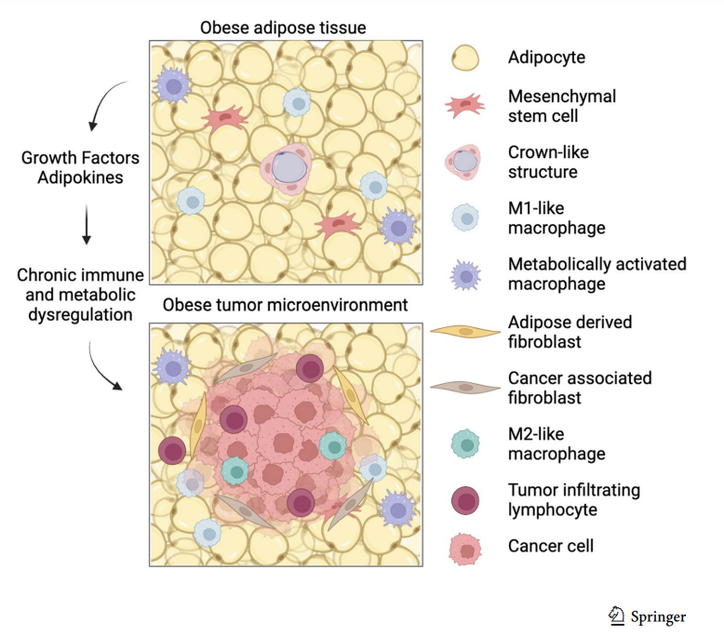
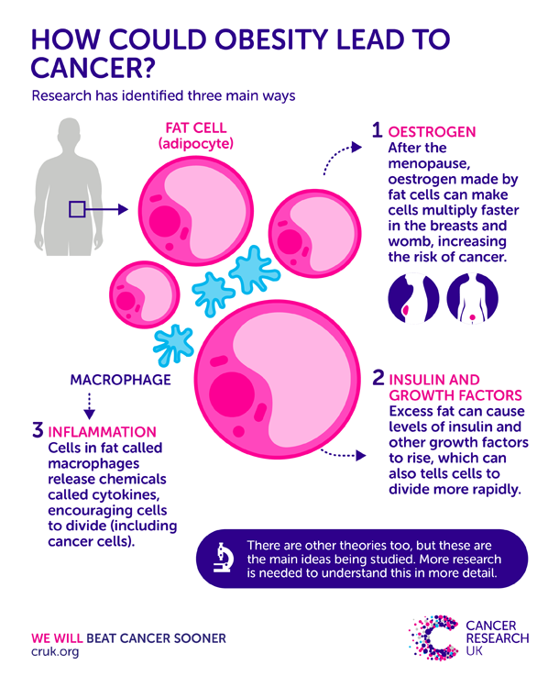
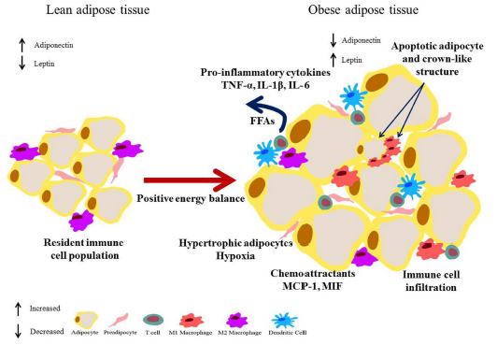

Slide 9
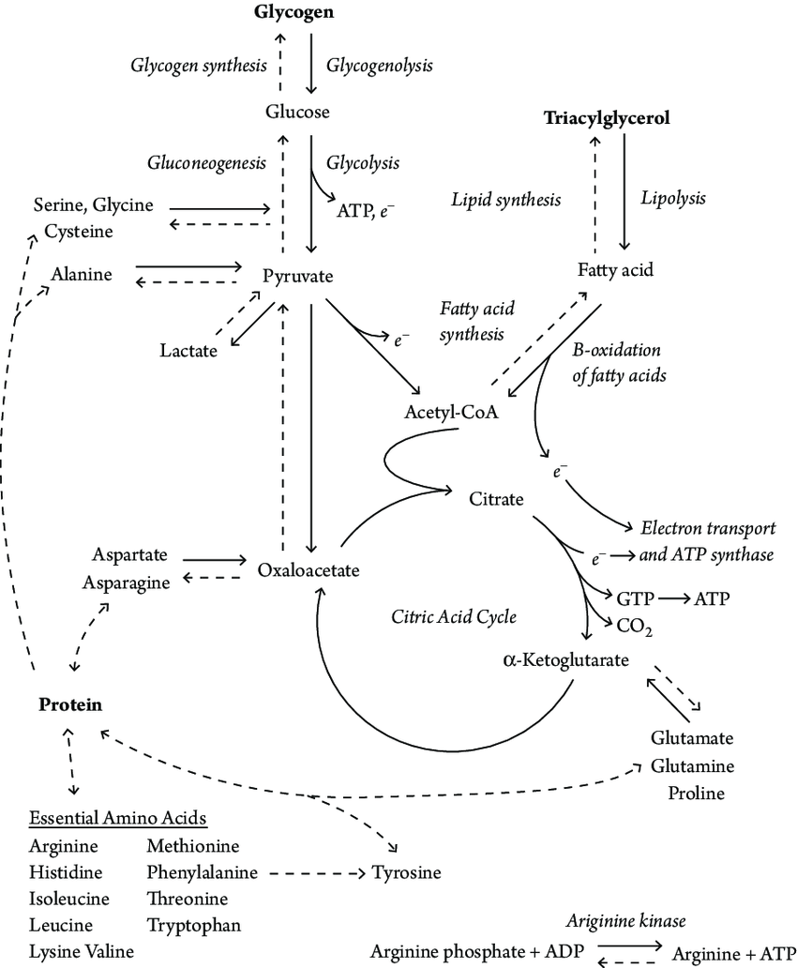
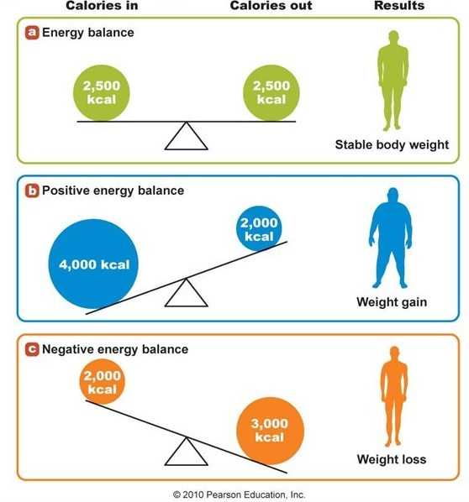
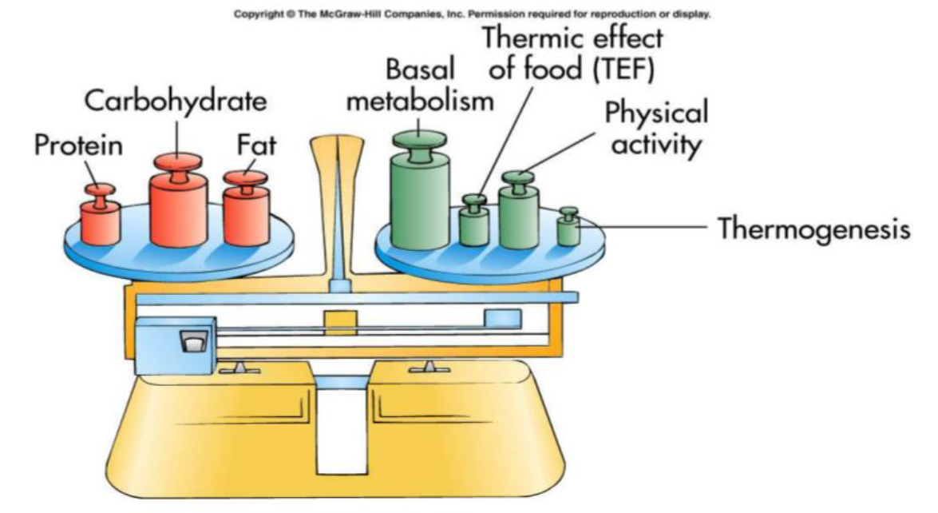
Obesity and Energy Metabolism
03
Obesity is characterized by the increase of body fat stores, as a result of chronic positive energy balance
Obesity

Slide 10
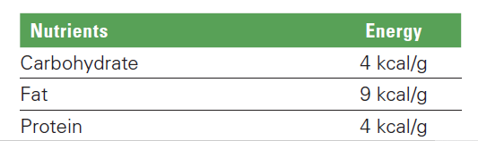
Calories In
Calories Out
Basic concept of energy balance
Law of thermodynamics says energy can neither be created nor be destroyed. It can be transferred from one form to another.
Notes:
Tubuh manusia itu pada esensinya, dia bekerja seperti alam ini bekerja, berusaha untuk menjaga keseimbangannya.
Sehingga untuk menjaga keseimbangannya, energy intake harus sama dengan energy output.
Energy intake, didapatkan dari makanan dan minuman yang berkalori, makanan yang mengandung substrat energy seperti karbohidrat, lemak dan protein. 1 gram karbohidrat akan menyumbang 4 kkal, 1 gram lemak 9 kkal, dan 1 gram protein 4 kkal.
Berdasarkan Hukum termodinamik, energi tidak dapat dicipatkan atau dimusnahkan, namun dirubah dalam bentuk yang lain. Maka tubuh kita bekerja untuk merubah asupan energi tadi dalam bentuk yang lain, menjadi energi untuk metabolisme basal, menjadi energi untuk mengolah makanan tadi melalui thermic effect of food atau thermogenesis, dan energi untuk beraktifitas fisik.
Mari kita bahas satu-satu

Slide 11




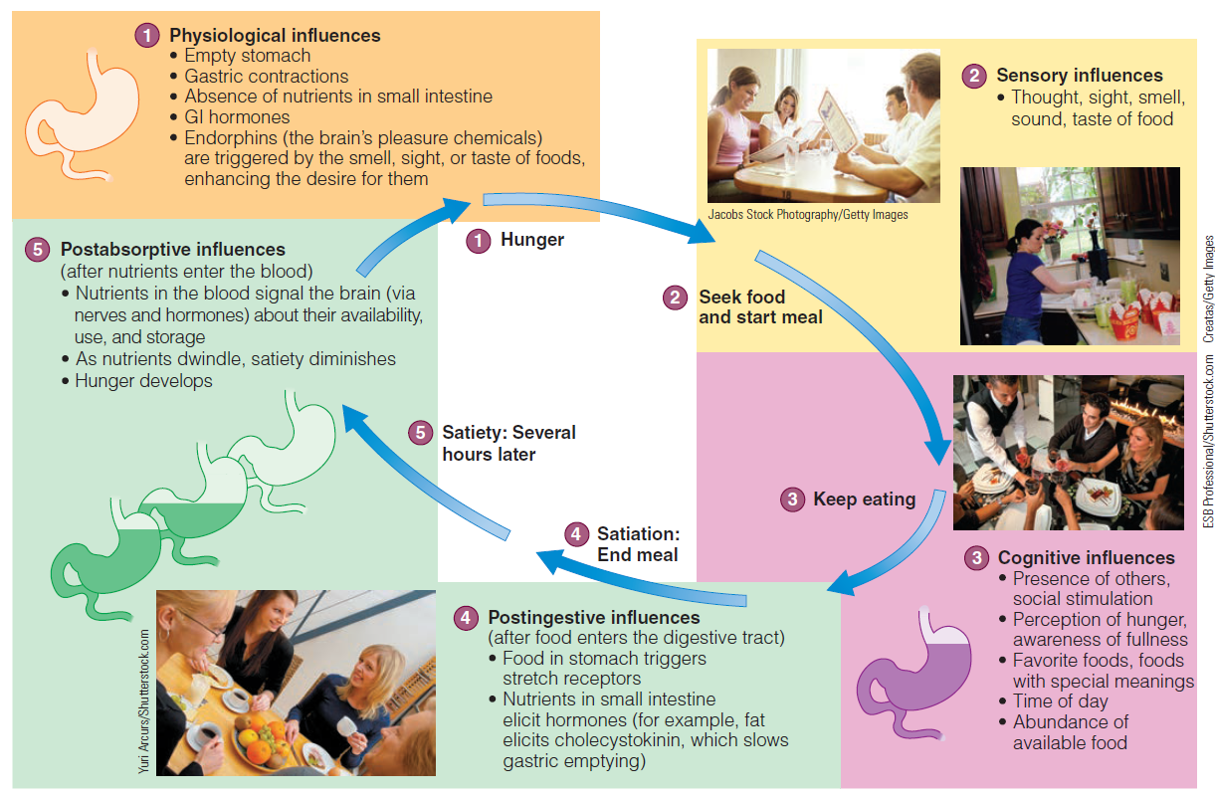
24-hr Dietary recall
Food / Beverage Items | Portion | Gram | Energy
-
-
Total Daily Energy Intake
Calories In
Hunger – Satiety Mechanism

Slide 12
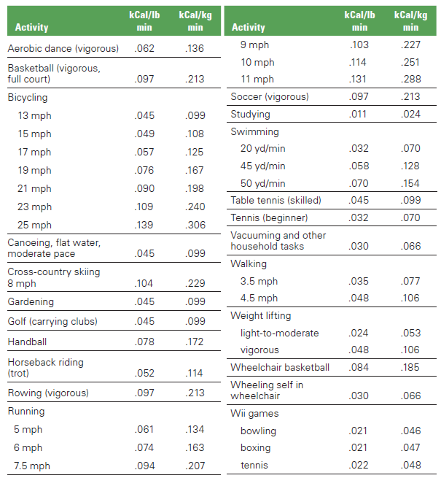
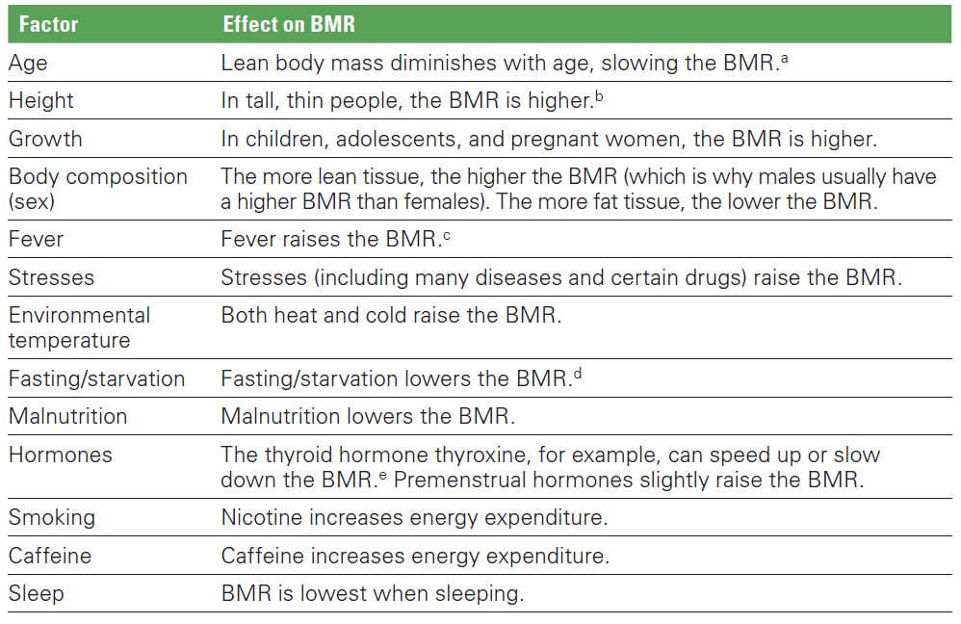
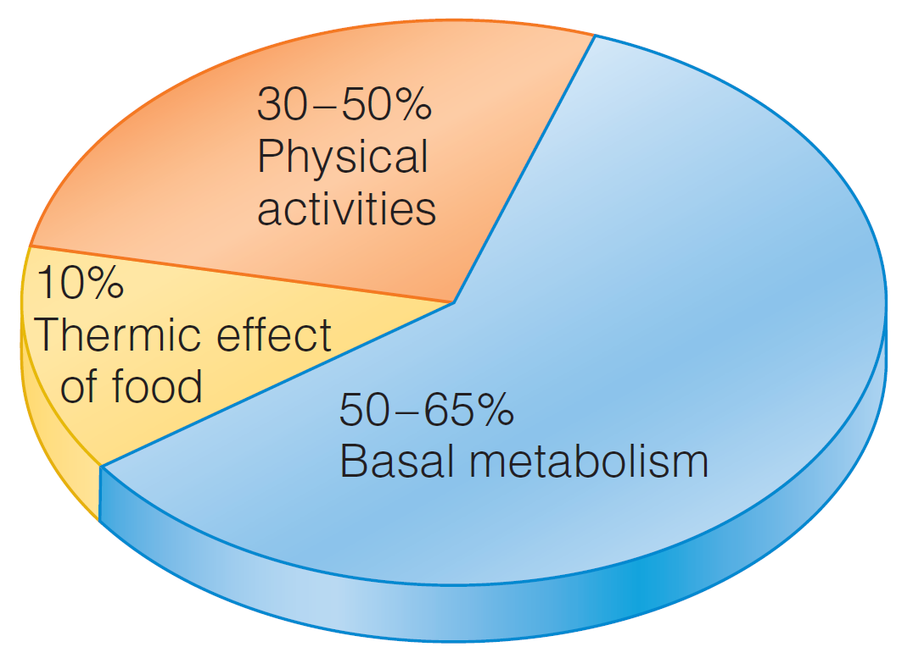
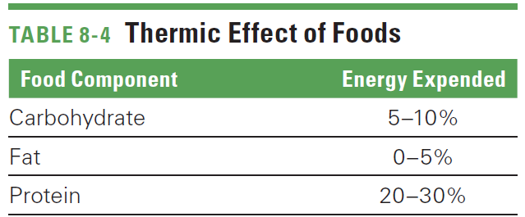
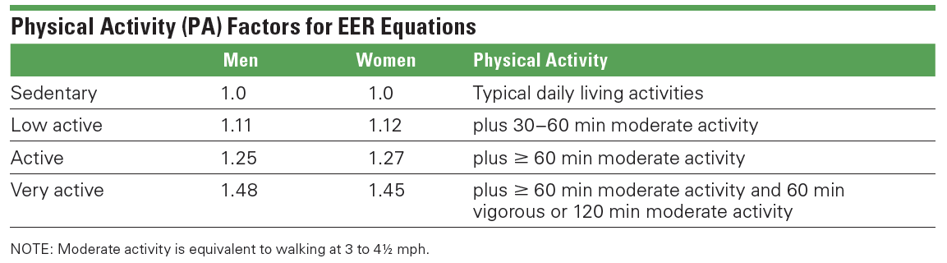
Calories Out
Estimated Energy Requirement
Men 19 years and older:
EER = [662 - (9.53 X age)] + PA [(15.91 X wt) + (539.6 X ht)]
Women 19 years and older:
EER 5 [354 - (6.91 X age)] + PA [(9.36 X wt) + (726 X ht)]

Slide 13
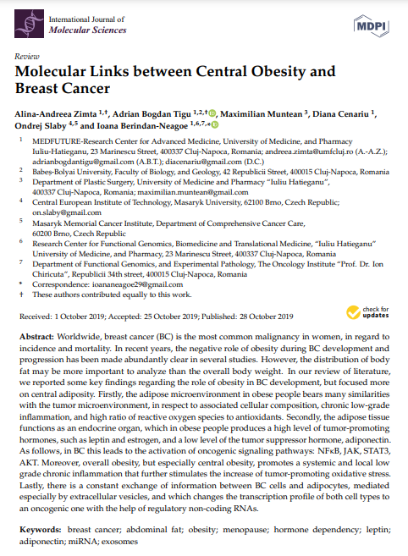
Body Mass Index (BMI) as an international parameter to determine obesity
Classification (WHO Asia Pasific) | BMI (kg/m2) | Risk of co-morbidities
 |  | Waist circumference
 |  | < 90 cm (men) | ≥ 90 cm (men)
 |  | < 80 cm (women) | ≥ 80 cm (women)
Underweight | < 18.5 | Low (but increase risk of other clinical problems) | Average
Normal range | 18.5 – 22.9 | Average | Increase
Overweight | ≥ 23.0
- At risk | 23.0 – 24.9 | Increased | Moderate
- Obese I | 25.0 – 29.9 | Moderate | Severe
- Obese II | ≥ 30.0 | Severe | Very severe

Slide 14
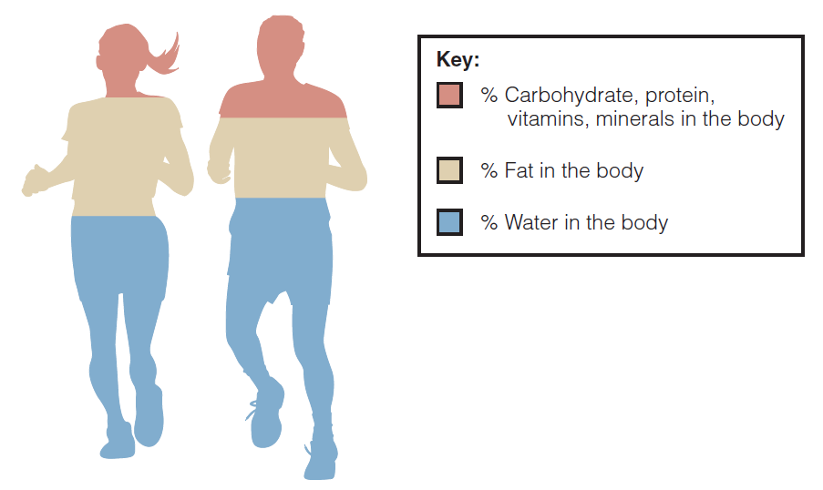
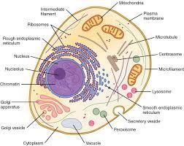
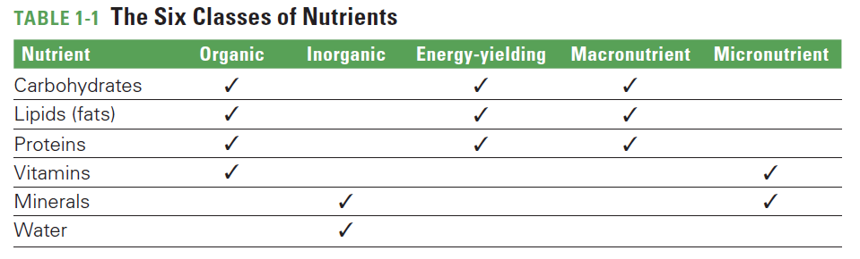
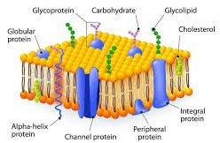
You Are What You Eat Concept
04
The human body is made of compounds similar to those found in foods—mostly water (60%) and
some fat with carbohydrate, protein, vitamins, minerals, and other minor constituents making up the remainder

Slide 15
“Apakah jenis makanan tertentu dapat menurunkan risiko kanker payudara?”
“Apakah jenis diet tertentu baik dilakukan saat menjalani kemoterapi ?”
“Apakah jenis makanan tertentu dapat mencegah rekurensi kanker payudara?”
“Apakah harus menurunkan berat badan saat menjalani pengobatan kanker payudara pada pasien obesitas ?
Etc.
Information about the nutritional content of food often forms a public opinion

Slide 16

Take Home Message
“
There is growing evidence that lifestyle factors, including diet, body weight, and obesity, may be associated with higher breast cancer risk. Nutritional intervention in patients may be considered an integral part of the multimodal therapeutic approach. However, the effect of dietary factors on breast cancer recurrence and mortality is not clearly understood, so further research related to nutrition and dietary in large population is required to definitively establish effective treatments in these patients, to improve long-term survival and quality of life.
“

Slide 17

Hatur nuhun

